Slide 1



SMART DOOR LOCK
MUHAMMAD Amirul Hakimi bin zaprunnizam

Slide 2
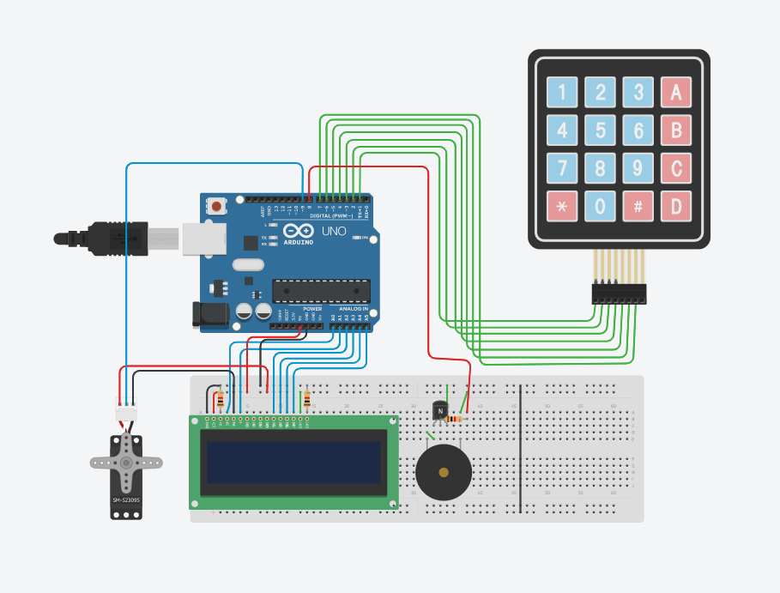
Circuit design Smart Lock Door | Tinkercad

